Slide 1
O PROCESSO DE CRIAÇÃO
DE UM ALGORITMO DE AI
Cristovam Scapulatempo Neto
Diretor médico de patologia e genômica DASA

Slide 2
Disclosure of Relevant Financial Relationships
Dr. Cristovam Scapulatempo Neto declares he has no
conflict(s) of interest to disclose
RDC Nº 96/08 da ANVISA

Slide 3
Introduction
Digital Pathology with Whole Slide Imaging allowed the development of Computational Pathology.
The lack of access of public available datasets of annotated images is a key factor to slow down the development of new AI algorithms.
. WSI is very recent (<10% of pathology labs are using)
. WSI images are tremendously large.
Current applications include:
. Tumor detection and classification . Mitosis detection.
. Image segmentation . Tumor grading.
. Cell detection and counting. . Analysis of kidney transplant biopsies

Slide 4
ARTIFICIAL INTELLIGENCE! WHY DO WE NEED IT?
Computational pathology has a huge potential for diagnostic transformation:
Quality control of the slides.
Distribution of the cases by specialties with the team that are working during the shift
Prioritization of positive cases.
Reduction of analysis time.
Quality control Reduction of diagnostic errors.
Increased medical production.
Complex analyzes for predicting biological behavior or drug response

Slide 5
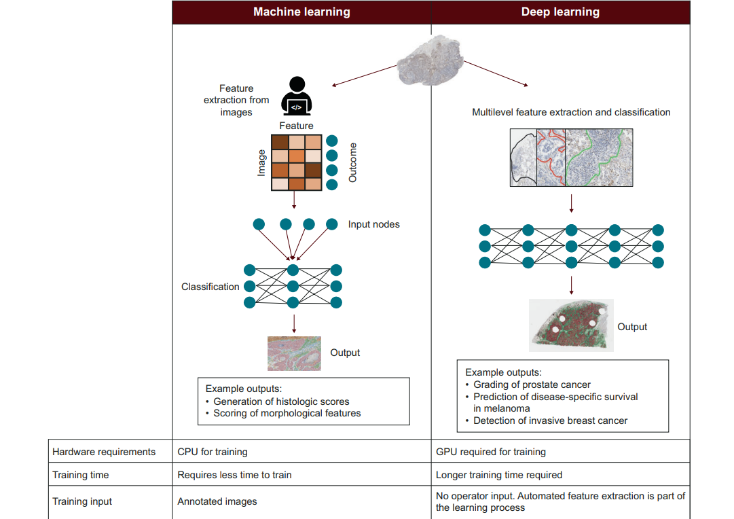
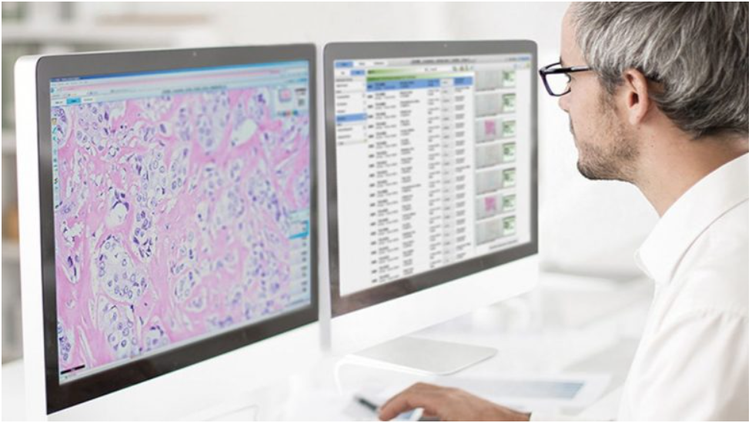
Algoritm creation
INCREASED COMPUTATIONAL CAPACITY
DIGITAL PATHOLOGY
AI ALGORITHMS
Modern Pathology (2022) 35:23–32

Slide 6
Algoritm creation
Machine learning (ML)
Algorithms and models that are trained on available data to predict, classify, and cluster them come under ML.
Machine learning models are never explicitly programmed; rather, they learn from patterns of data.
Deep learning (DL)
It uses artificial neural networks to work on datasets and perform tasks. The unit cells of these neural networks are neurons, which mimic the functioning of the human brain.
Modern Pathology (2022) 35:23–32

Slide 7
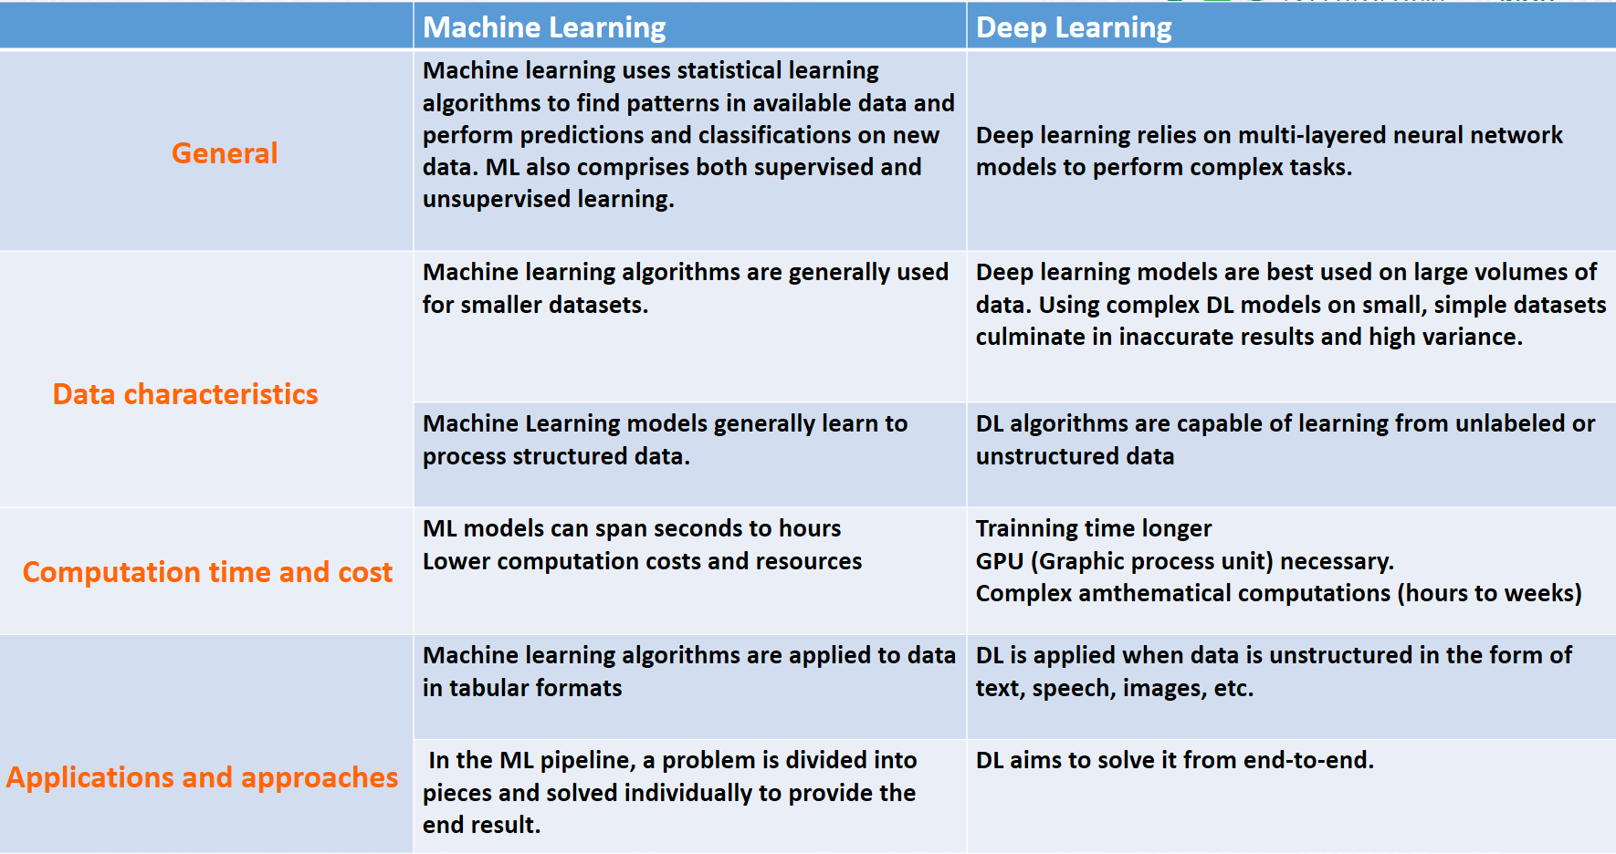
MACHINE LEARNING VS DEEP LEARNING
https://www.turing.com/kb/ultimate-battle-between-deep-learning-and-machine-learning

Slide 8
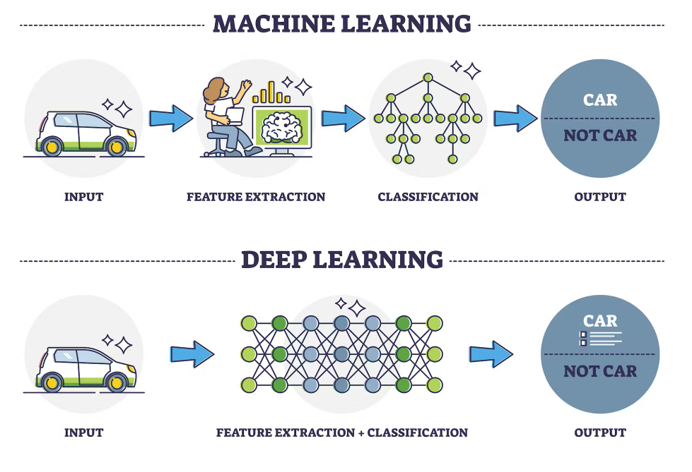
MACHINE LEARNING VS DEEP LEARNING
https://www.turing.com/kb/ultimate-battle-between-deep-learning-and-machine-learning

Slide 9

CHALLENGES FOR AI CONSTRUCTION
Preanalytic and Analytic factors
. Section Thickness
. Tinctorial characteristics of H&E stain
. Scanners used (diferente brightness, sharpness, image type and compression, etc....)
These characteristics brings challenges to validate the AI algorithm in most laboratories.
. Normalization from different H&E stains and a pre analytical tissue disturbances

Slide 10
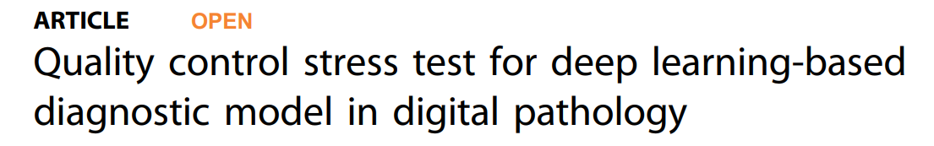
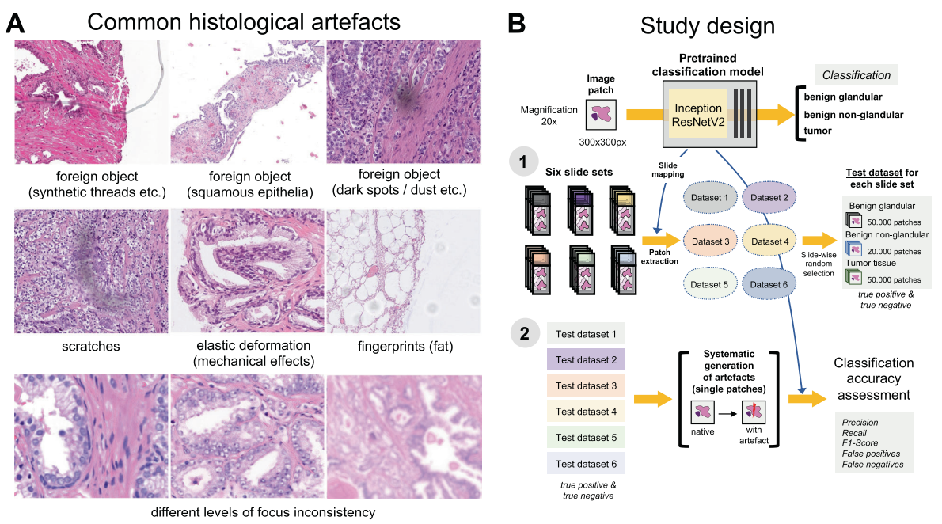
CHALLENGES FOR AI CONSTRUCTION
Modern Pathology (2021) 34:2098–2108
Notes:
Fig. 1 Common histological artifacts in digital pathology and study design. A Some of the common artifacts in digital pathology. B Study design. A pre-trained and validated model for prostate cancer detection [4] based on InceptionResNetV2 convolutional architecture was used in this study providing classification among benign glandular, benign nonglandular, and tumor tissue. Step 1: six test datasets were created (Supplementary Table 1 for characteristics) containing a random selection of only true positive (tumor class, 50,000 patches) and true negative patches (benign glandular class, 50,000 patches, and benign nonglandular class, 20,000 patches), correctly recognized by the model at baseline. Step 2: every of 12 studied artifacts or analytical situations were computationally generated for every single patch in six test datasets to test model accuracy in presence of these artifacts

Slide 11
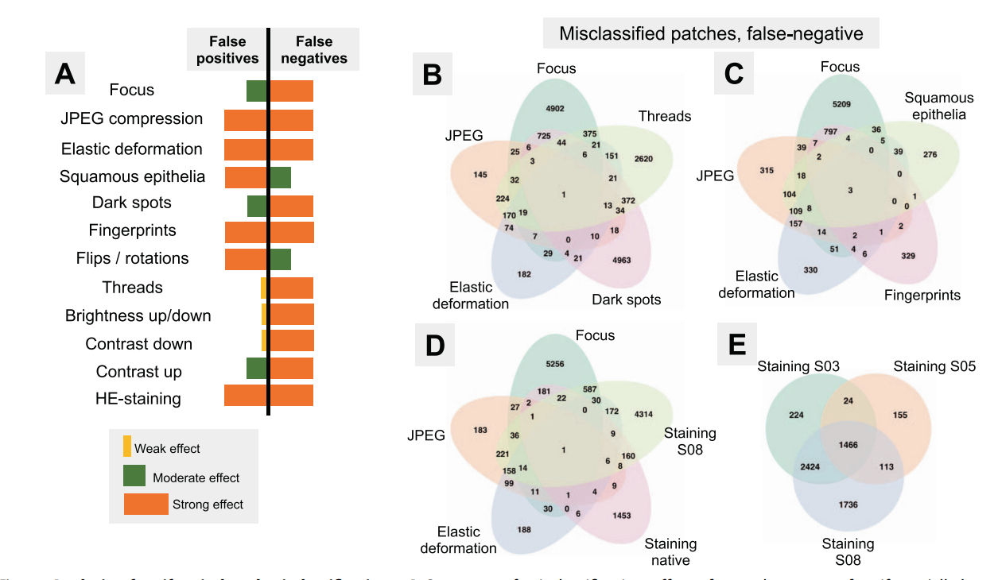
CHALLENGES FOR AI CONSTRUCTION
Artifacts on slides are frequent causes of false positives and false negatives.
For greater reproducibility of algorithms, they must be validated taking into account artifacts that can be artificially created.
Modern Pathology (2021) 34:2098–2108
Notes:
Fig. 1 Common histological artifacts in digital pathology and study design. A Some of the common artifacts in digital pathology. B Study design. A pre-trained and validated model for prostate cancer detection [4] based on InceptionResNetV2 convolutional architecture was used in this study providing classification among benign glandular, benign nonglandular, and tumor tissue. Step 1: six test datasets were created (Supplementary Table 1 for characteristics) containing a random selection of only true positive (tumor class, 50,000 patches) and true negative patches (benign glandular class, 50,000 patches, and benign nonglandular class, 20,000 patches), correctly recognized by the model at baseline. Step 2: every of 12 studied artifacts or analytical situations were computationally generated for every single patch in six test datasets to test model accuracy in presence of these artifacts

Slide 12
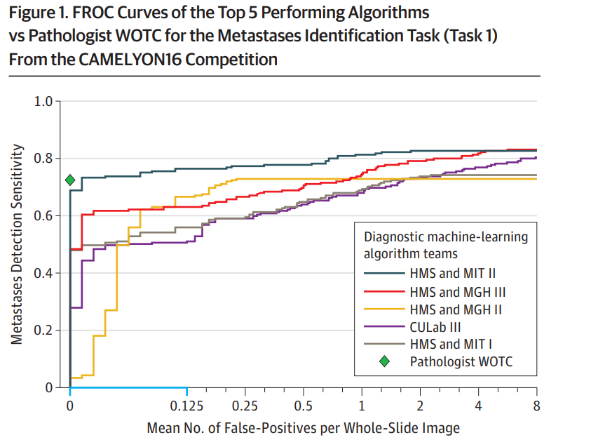
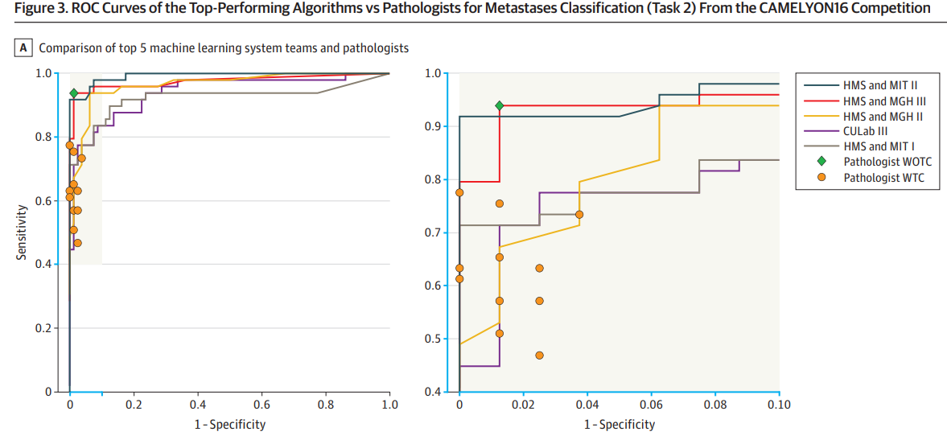
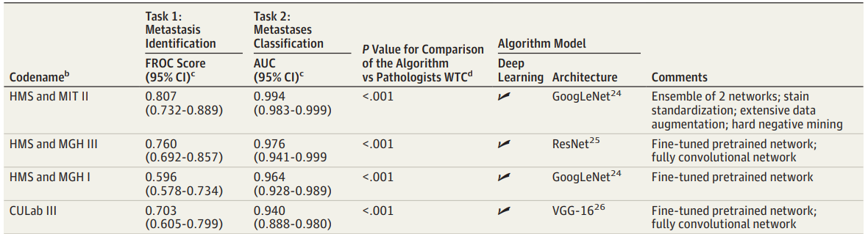
Algoritm creation
CAMELYON CHALENGE 16
Game changer in the field of computed pathology.
Largest collection (n=1,399) of fully manually
annotated WSIs of sentinel lymph nodes of patients with breast cancer.
2 tasks:
. Finding tumor regions in each lymph node
. Predicting the presence of tumors at a WSI level
Sci Rep. 2017 Apr 18;7:46450.
. Trainning : 110 with and 160 without mets.
. Validation: 49 with and 80 without met
FROC evaluates tumor detection and localization
https://digitalpathologyassociation.org/_data/cms_files/files/API/CAMELYON_vanderlaak.pdf
JAMA. 2017;318(22):2199-2210

Slide 13
Steps of AI Algoritm implementation
TRAINNING SET
First set of images to train an algorithm.
Should simulate real life.
More variations brings more reproducibility in different scenarios, allowing it´s implementation for diagnostic use in different labs.
- An adequate training set is mandatory for the algorithm learning.
Sci Rep. 2017 Apr 18;7:46450.

Slide 14
Steps of AI Algoritm implementation
VALIDATION SET
After an algoritm be trainned it should be validated in a set of real cases.
Theses cases need to be real cases that were not used in the algorithm training.
More variation of slides from different labs and scanned slides in different scanners.
Higher the accuracy of the Algorithm in diferent scenarios more prone it is to be used in clinical practice in different labs.

Slide 15
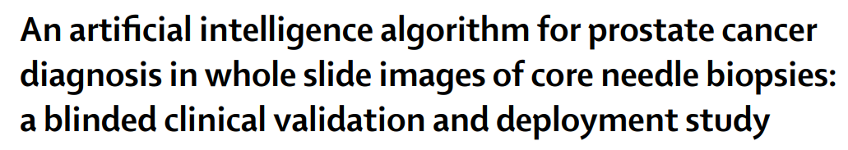
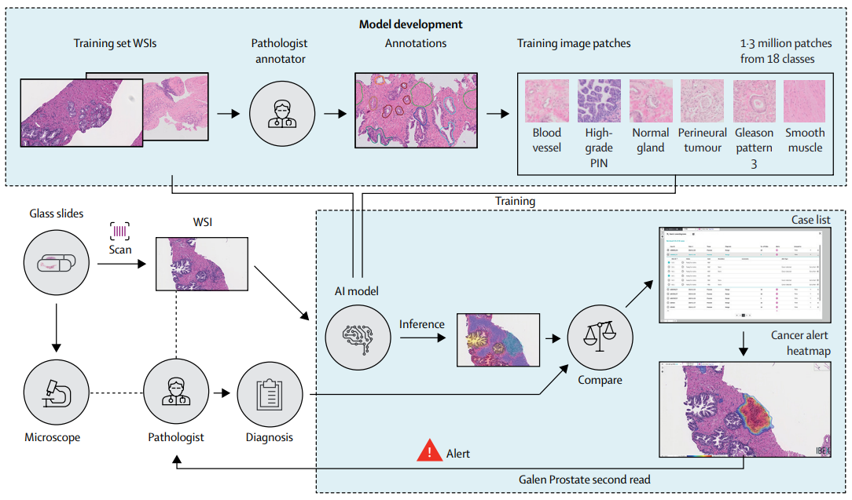
Algoritm creation
GALEN PROSTATE (IBEX)
Development (Philips Scanner)
Training (1357480 image patches from 549 H&E-stained slides)
Internal test (2501 H&E-stained slides) datasets.
Validation (AT2 APERIO)
- external dataset of 100 consecutive cases (1627 H&E-stained slides)
Patologista | AI
Benigno | Positivo
Gleason 6 | Gleason >7
Sci Rep. 2017 Apr 18;7:46450.

Slide 16
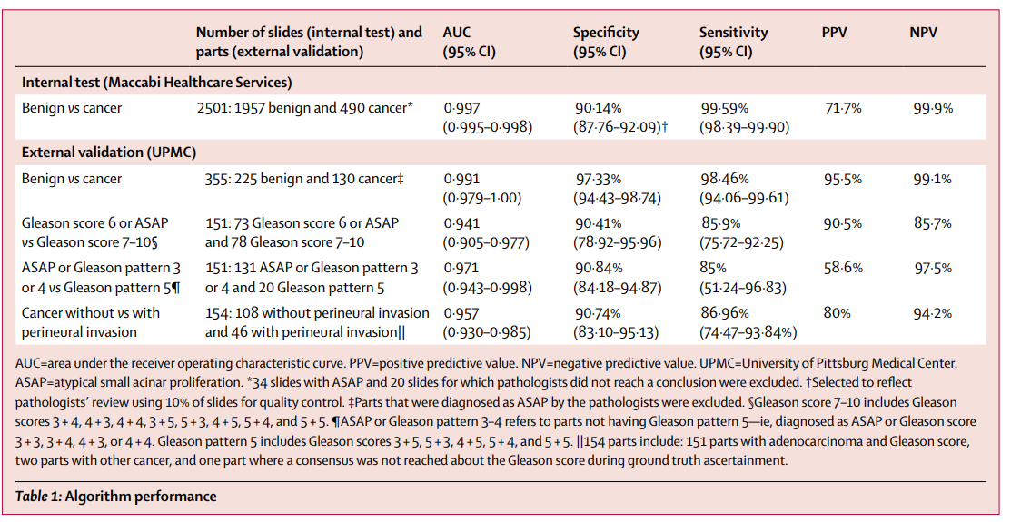
Algoritm creation
Lancet Digital Health 2020; 2: e407–16

Slide 17
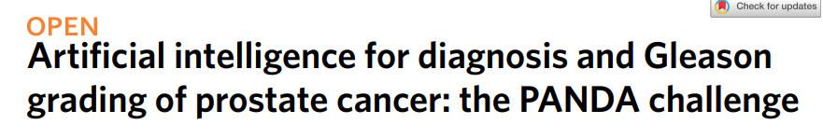
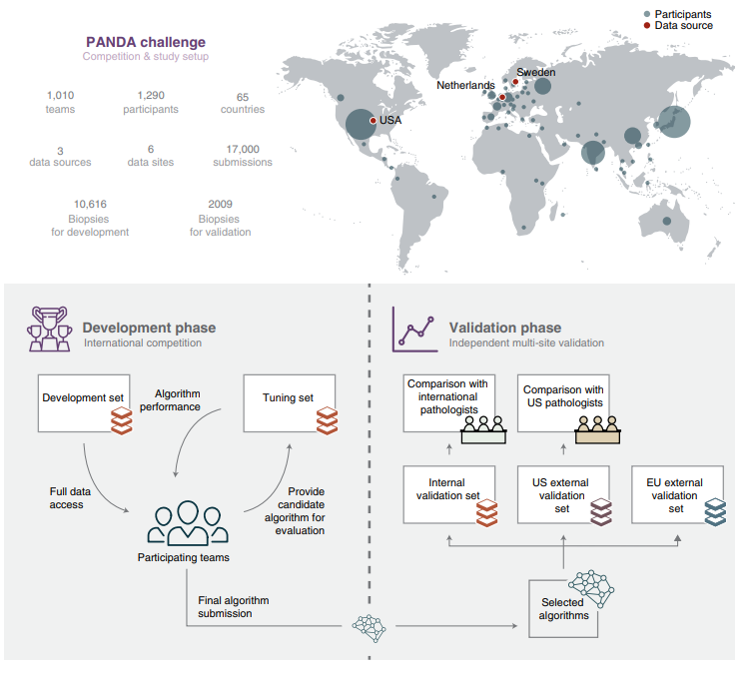
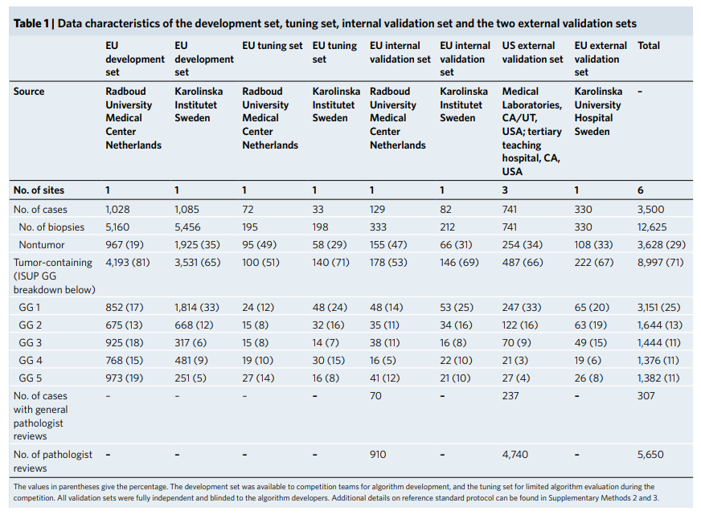
Nat Med 28, 154–163 (2022).

Slide 18
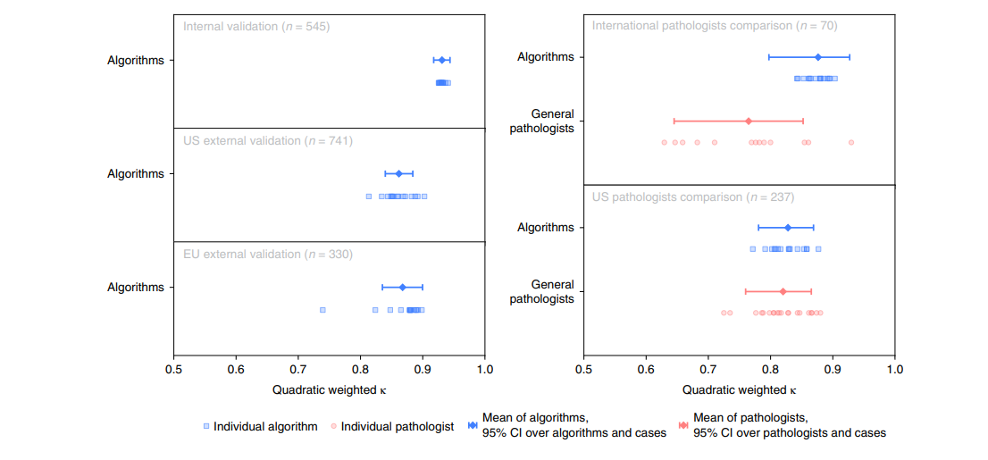
“Diagnostic quality improves when pathologists use AI as a digital second opinion, in particular less experienced doctors.
Nat Med 28, 154–163 (2022).

Slide 19
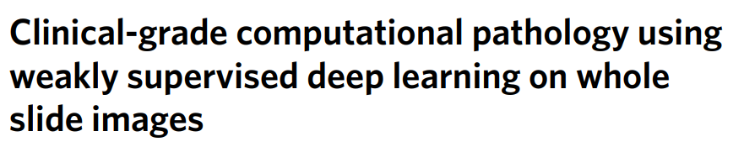
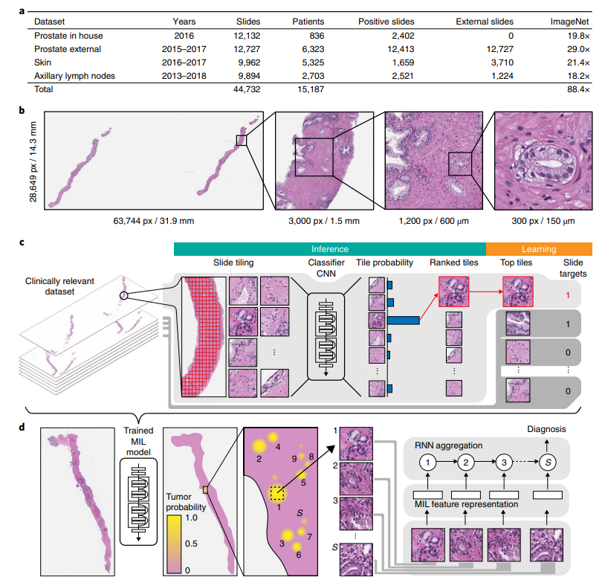
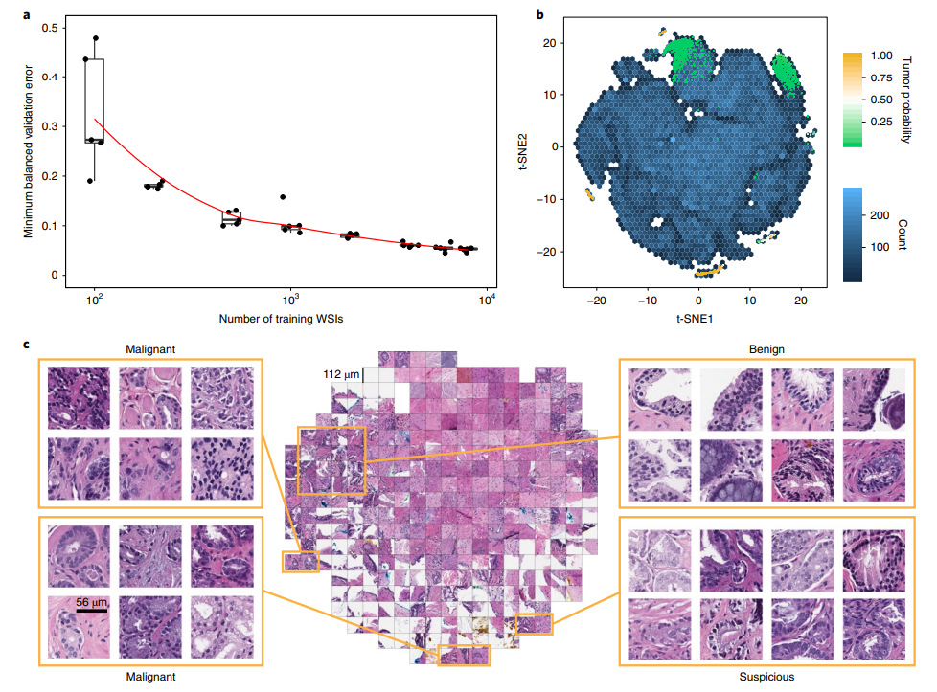
CHALLENGES FOR AI CONSTRUCTION
Weakly supervised = not annotated slides
MIL= Multiple instances learning
Nat Med 25, 1301–1309 (2019).
Notes:
Fig. 1 | Overview of the data and proposed deep learning framework presented in this study. a, Description of the datasets. This study is based on a total of 44,732 slides from 15,187 patients across three different tissue types: prostate, skin and axillary lymph nodes. The prostate dataset was divided into in-house slides and consultation slides to test for staining bias. The class imbalance varied from 1:4 for prostate to 1:3 for breast. A total of 17,661 slides were submitted to MSK from more than 800 outside institutions in 45 countries for a second opinion. To put the size of our dataset into context, the last column shows a comparison, in terms of the pixel count, with ImageNet—the state of the art in computer vision, containing over 14 million images. b, Left, hematoxylin and eosin slide of a biopsy showing prostatic adenocarcinoma. The diagnosis can be based on very small foci of cancer that account for r <1%
of the tissue surface. In the slide to the left, only about six small tumor glands are present. The right-most image shows an example of a malignant gland.
Its relation to the entire slide is put in perspective to reiterate the difficulty of the task. c, The MIL training procedure includes a full inference pass through
the dataset, to rank the tiles according to their probability of being positive, and learning on the top-ranking tiles per slide. CNN, convolutional neural
network. d, Slide-level aggregation with a recurrent neural network (RNN). The S most suspicious tiles in each slide are sequentially passed to the RNN to
predict the final slide-level classification.
Fig. 2 | Dataset size impact and model introspection. a, Dataset size plays an important role in achieving clinical-grade MIL classification performance. Training of ResNet34 was performed with datasets of increasing size; for every reported training set size, five models were trained, and the validation errors are reported as box plots (n= 5). This experiment underlies the fact that a large number of slides are necessary for generalization of learning under the MIL assumption. b,c, The prostate model has learned a rich feature representation of histopathology tiles. b, A ResNet34 model trained at 20× was used to obtain the feature embedding before the final classification layer for a random set of tiles in the test set (n= 182,912). The embedding was reduced to two dimensions with t-SNE and plotted using a hexagonal heat map. Top-ranked tiles coming from negative and positive slides are represented by points colored by their tumor probability. c, Tiles corresponding to points in the two-dimensional t-SNE space were randomly sampled from different regions. Abnormal glands are clustered together on the bottom and left sides of the plot. A region of tiles with a tumor probability of ~0.5 contains glands with features suspicious for prostatic adenocarcinoma. Normal glands are clustered on the top left region of the plot.a, Dataset size plays an important role in achieving clinical-grade MIL classification performance. Training of ResNet34 was performed with datasets of increasing size; for every reported training set size, five models were trained, and the validation errors are reported as box plots (n= 5). This experiment underlies the fact that a large number of slides are necessary for generalization of learning under the MIL assumption. b,c, The prostate model has learned a rich feature representation of histopathology tiles. b, A ResNet34 model trained at 20× was used to obtain the feature embedding before the final classification layer for a random set of tiles in the test set (n= 182,912). The embedding was reduced to two dimensions with t-SNE and plotted using a hexagonal heat map. Top-ranked tiles coming from negative and positive slides are represented by points colored by their tumor probability. c, Tiles corresponding to points in the twodimensional t-SNE space were randomly sampled from different regions. Abnormal glands are clustered together on the bottom and left sides of the plot. A region of tiles with a tumor probability of ~0.5 contains glands with features suspicious for prostatic adenocarcinoma. Normal glands are clustered on the top left region of the plot.

Slide 20
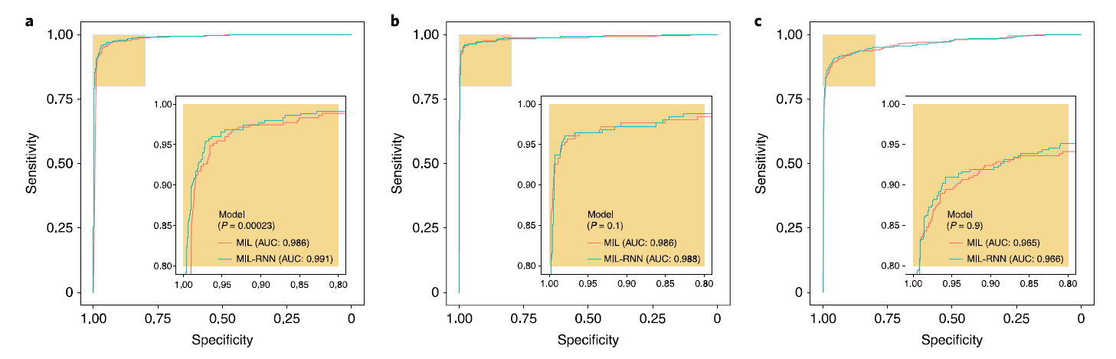
CHALLENGES FOR AI CONSTRUCTION
Prostate cancer (n=1784)
MIL-RNN: AUC 0,99
Basal cell carcinoma model (n=1575)
AUC 0,98
Breast metastasis detection model (n=1473)
AUC 0,96
Weakly supervised = not annotated slides
MIL= Multiple instances learning
RNN= Recurrent neural network
Nat Med 25, 1301–1309 (2019).

Slide 21
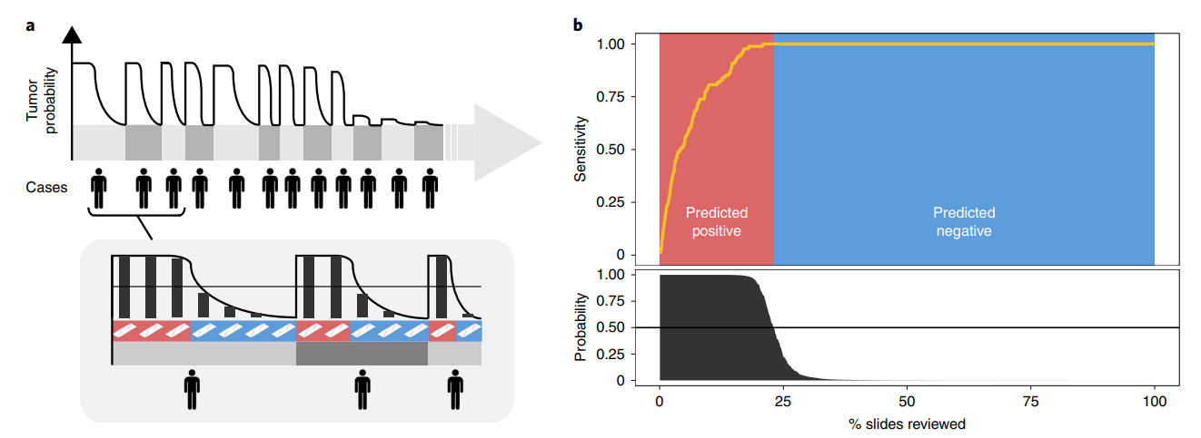
CHALLENGES FOR AI CONSTRUCTION
Weakly supervised = not annotated slides
MIL= Multiple instances learning
RNN= Recurrent neural network
Nat Med 25, 1301–1309 (2019).

Slide 22
CONCLUSION
COMPUTATIONAL PATHOLOGY IS INCREASING IN PARALLEL OF DIGITAL PATHOLOGY IMPLEMENTATION.
AVAILABLE ANNOTATED IMAGES ARE A KEY FACTOR TO ALLOW CREATION OF NEW AI ALGORITHMS.
A BIG EFFORT SHOULD BE DONE TO CREATE PUBLIC ANNOTETED IMAGE BANKS FOR RAPID AVAILABILITY OF NEW DIAGNOSTIC / PROGNOSTIC ALGORITHMS.
MORE VARIATIONS IN TRAINNING AND VALIDATION SETTINGS ARE IMPORTANT TO OBTAIN MORE USABLE ALGORITHMS.
AI IS A POWERFULL TOOL TO INCREASE PRODUCTIVITY AND QUALITY CONTROL.
PATHOMICS WILL BE AVAILABEL SOON, BRINGGING TOGETHER HISTOLOGICAL, IMMUNOHISTOCHEMICAL AND MOLECULAR ASPECTS OF THE TUMORS.
UNFORTUNATELLY AVAILABLE AI ALGORITHMS ARE NOT ABLE TO EVALUATE ALL ASPECTS OF THE TISSUE CONCERNIG CANCER, INFLAMATION, INFECTION,ETC...

Slide 23

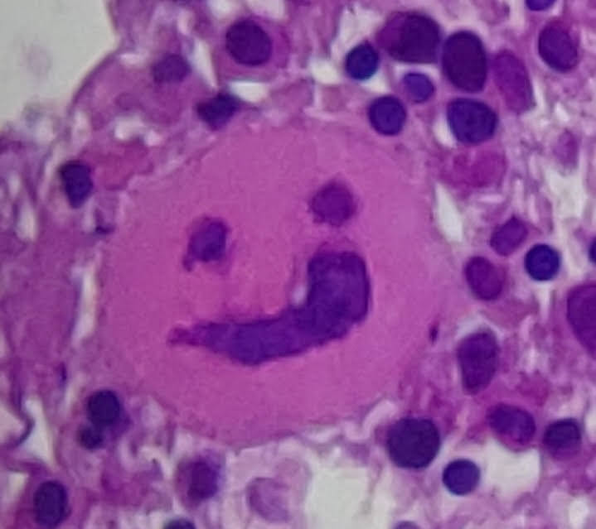

THANK YOU FOR YOUR ATTENTION
Cristovam Scapulatempo Neto
Diretor médico de Anatomia Patológica e Genética
Cristovam.neto@altadiagnosticos.com.br
11-992422218

Slide 24
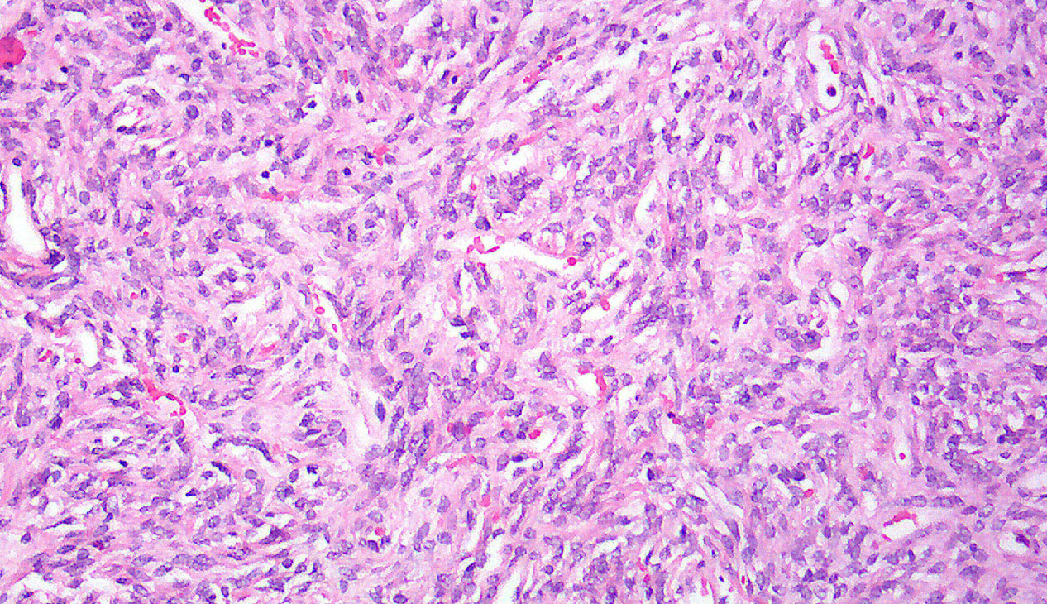


Slide 25
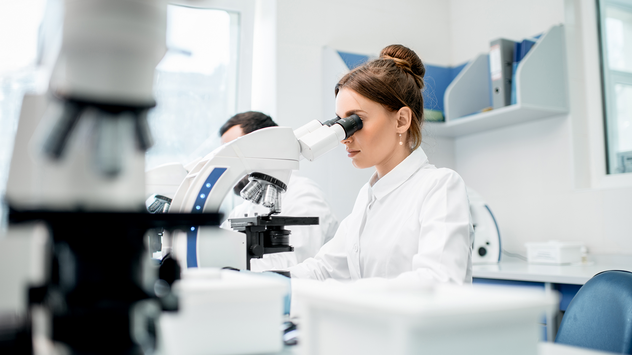


Slide 26
obrigado(A)!

Slide 27
Thank You!

Slide 28
obrigado(A)!

Slide 29
Thank you!

